Slide 1
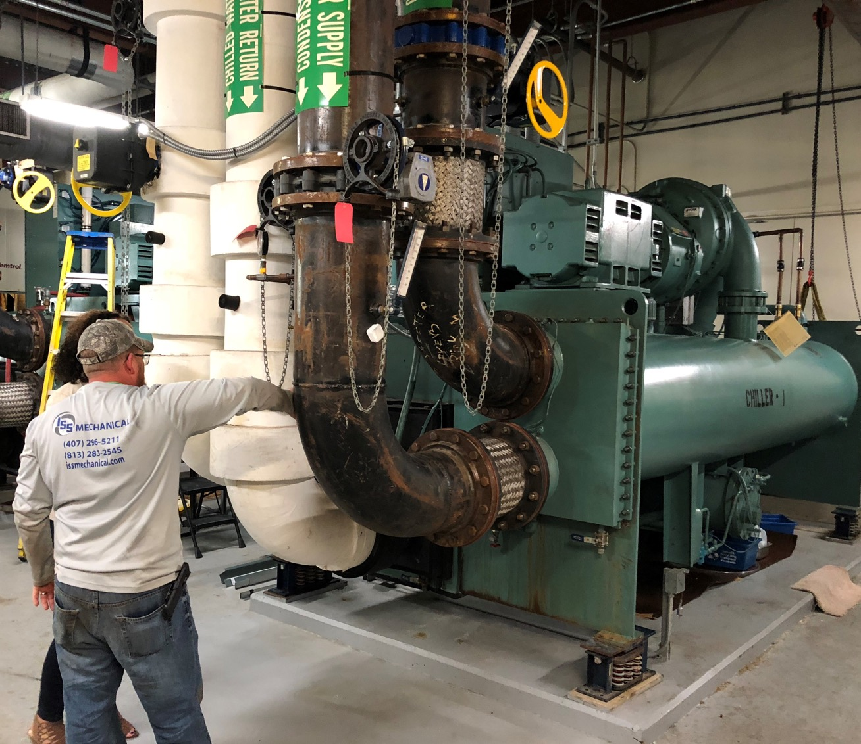


BUILDING FUTURES TOGETHER

Slide 2


ABOUT ISS MECHANICAL
For nearly 20 years, ISS Mechanical has provided a comprehensive commercial HVAC solution. Our team of experts is well equipped to provide a wide range of services—from service maintenance and replacements to full-scale system design and installation—that makes ISS Mechanical your true HVAC partner.

Slide 3
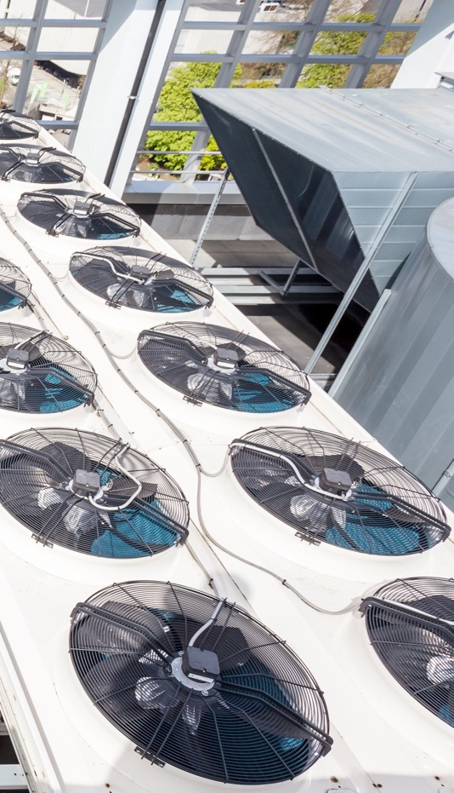
WHY PARTNER WITH US?
ISS Mechanical has developed a sterling reputation for both quality and project efficiency. We provide the highest quality and most professional technicians in our industry through constant training and certifications.

Slide 4

SERVICE FIRST
We are a service-first company that is committed to maximizing the value of our partners’ mechanical systems. Our mechanical expertise will:
Extend the Life of Your System
Increase Energy Efficiency
Reduce Equipment Downtime

Slide 5
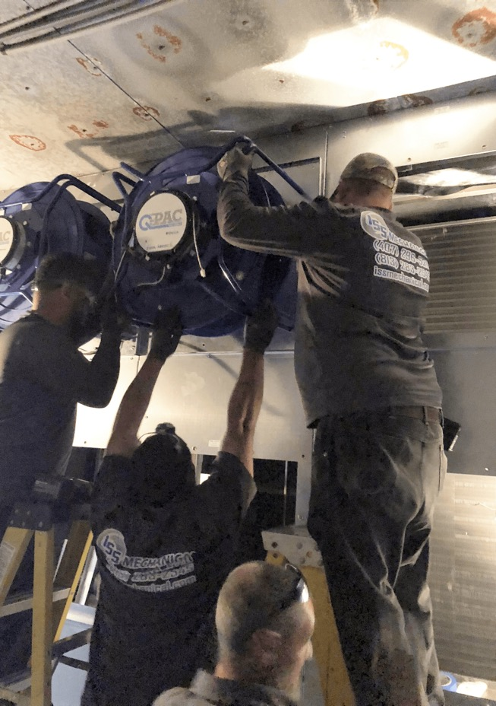
OUR HVAC SERVICES
The team at ISS Mechanical is equipped to handle HVAC equipment of any size or scope. From a medical clinic that needs regular tune-ups for their HVAC systems to large manufacturing plants with complex systems, we improve function and drive energy efficiency.
Maintenance and Repair
Equipment Upgrade and Replacement
Building Automation

Slide 6
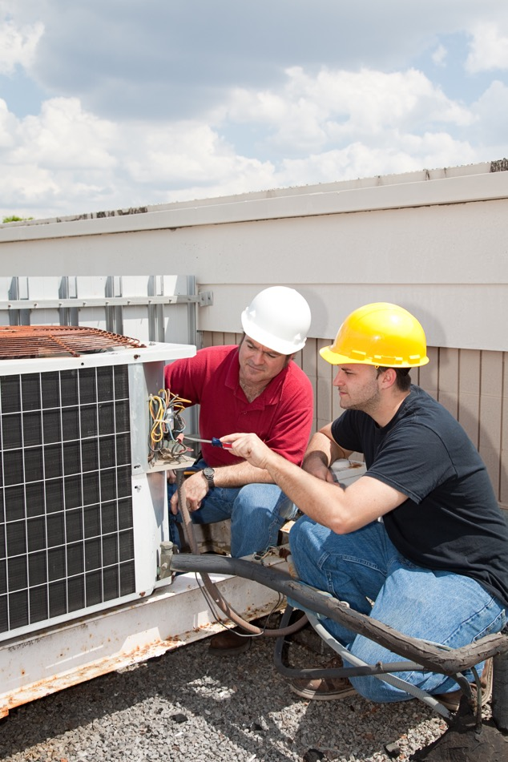

Complete Maintenance and Repair
Maintenance Agreements – Solving issues before they balloon into unexpected repairs
ISS Visual Intelligence– Using XOi technology to
provide photo and video history of our services provided
Emergency Repairs – Solving unexpected shutdowns
and failure with rapid response

Slide 7
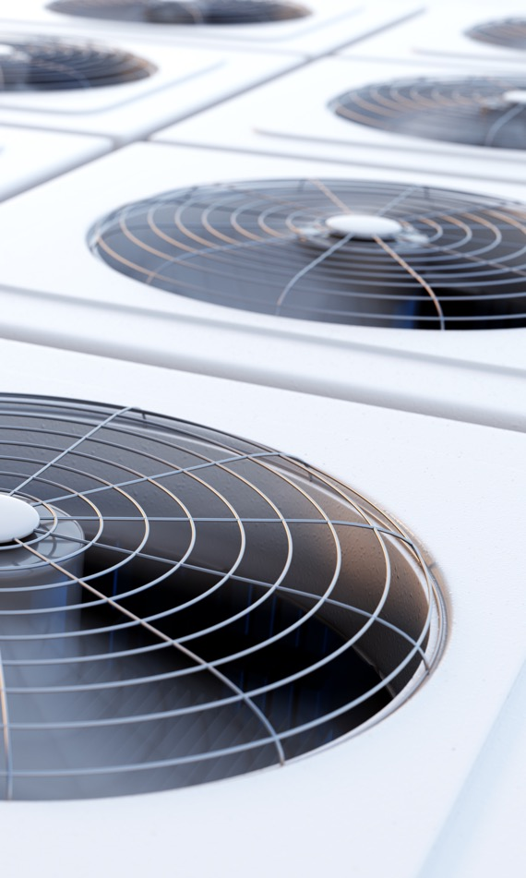
Integration and Upgrades
As technology evolves, HVAC systems can become drastically more efficient and robust. ISS Mechanical takes time to get to know our clients’ particular systems and then develops a long-term strategy to ensure they’re leveraging the latest and greatest in HVAC.

Slide 8

Building Automation Tools
One of the most effective ways to make a mechanical system more efficient is through building automation. These tools, installed by ISS Mechanical, are designed to monitor and detect conditions inside your facility—plus the status of your equipment—so that HVAC equipment is controlled precisely.

Slide 9
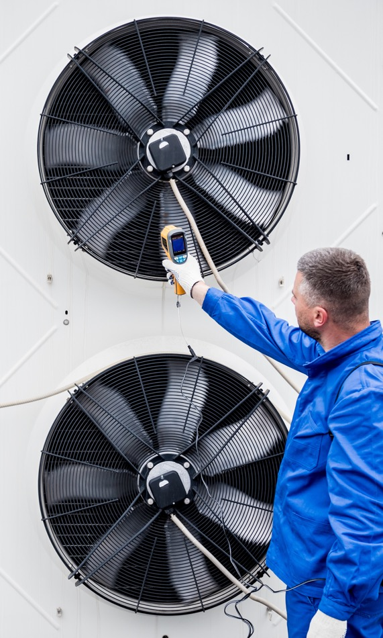
Benefits of Our
Total HVAC Solution
There are a variety of benefits to engaging in a holistic HVAC service program that includes a planned maintenance agreement.
Improved Indoor Air Quality
Reduces System Downtime
Fewer Repairs and Lower Costs
Rapid Emergency Response
Extend Equipment Life

Slide 10
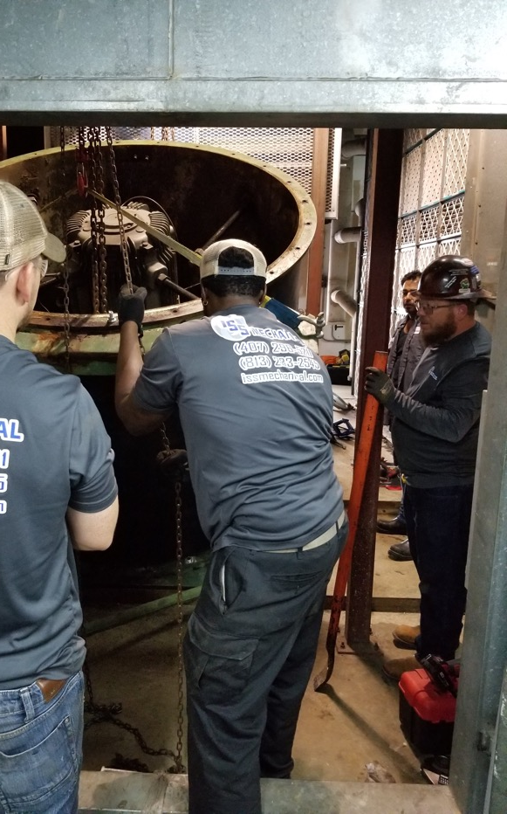
LET’S GET STARTED
The first step in taking on projects of any scope that align with the specific goals of each of our clients is a consultation and system inspection. Once we have a complete understanding of your facility and equipment, we can develop a custom-tailored solution to fit your needs.

Slide 11
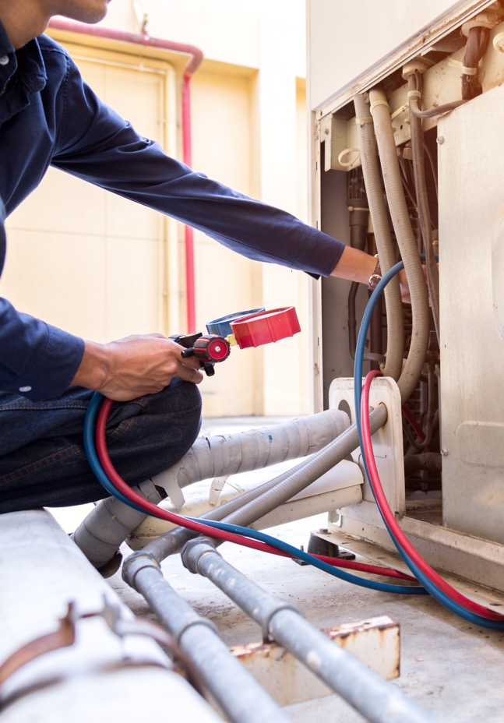
CONTACT US
www.issmechanical.com
3144 N. John Young Pkwy., Orlando, FL 32804
407-296-5211
2430 S US Highway 301, Tampa, FL 33619
813-283-2545

